Slide 1

Blockchain-based e-Voting: Secure and Transparent Elections
Blockchain technology has the potential to revolutionize the way we conduct elections, offering a secure and transparent voting system that can enhance the integrity of the democratic process.

Slide 2

Introducing the Blockchain Technology
1
Decentralized Network
2
Cryptographic Security
Blockchain is a decentralized, distributed digital ledger that records transactions across many computers in a network.
Transactions are secured through cryptography, making the blockchain immutable and resistant to modifications.
3
Transparency and Trust
The distributed nature of the blockchain ensures transparency and builds trust in the system.

Slide 3
Benefits of Blockchain for Voting Systems
Secure Voting
Transparency
Cost Savings
Blockchain-based voting systems provide a secure and tamper-resistant platform for casting and verifying votes.
The transparent nature of the blockchain allows voters to monitor the entire voting process and verify the integrity of the results.
Blockchain voting can reduce the operational costs associated with traditional voting systems, making elections more efficient.

Slide 4

Ensuring Voter Privacy and Anonymity
Voter Anonymity
Digital Identity
Secure Transactions
Blockchain-based voting systems can ensure voter anonymity by using cryptographic techniques to protect individual identities.
Voters can be authenticated using digital identities, allowing them to cast their votes without revealing their personal information.
Blockchain technology ensures that each vote is recorded securely and without the possibility of tampering or manipulation.

Slide 5
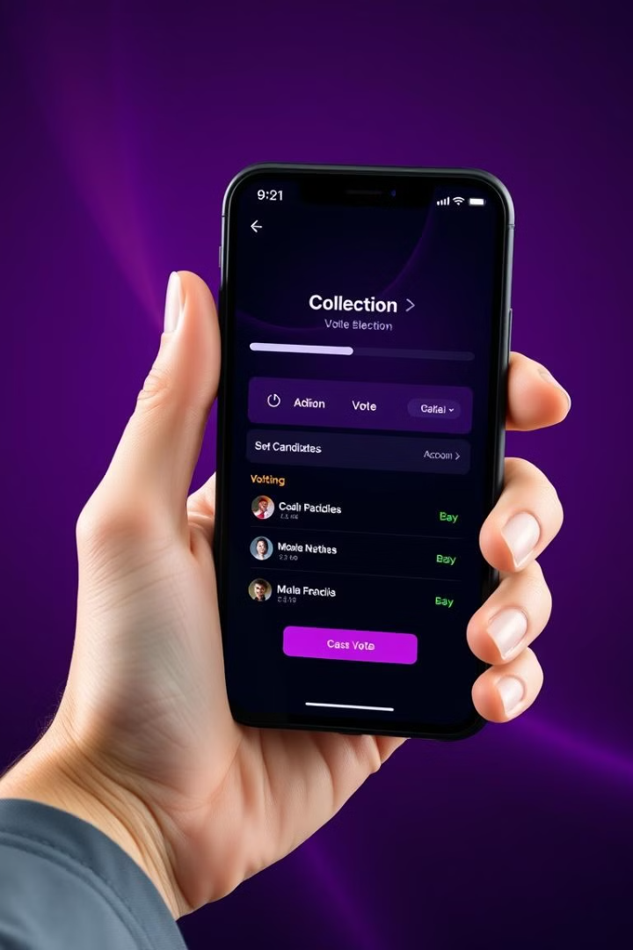



Preventing Voter Fraud and Tampering
Secure Voting
Blockchain's cryptographic security measures make it virtually impossible to tamper with voting records.
Verifiable Votes
Voters can verify that their votes have been recorded correctly and have not been altered.
Tamper-Proof
The distributed nature of the blockchain ensures that the voting system is resistant to tampering or manipulation.

Slide 6

Decentralized Voting Process Workflow
Voter Registration
Vote Tallying
Voters are registered and authenticated using secure digital identities on the blockchain.
The votes are tallied securely and transparently on the distributed ledger, ensuring the integrity of the results.
1
2
3
Vote Casting
Voters cast their ballots, which are recorded on the blockchain as encrypted, tamper-proof transactions.

Slide 7




Scalability and Reliability of the System
Scalable Architecture
The decentralized nature of the blockchain allows the voting system to scale to handle large volumes of voters.
High Availability
The distributed network of nodes ensures the voting system remains operational even in the event of individual failures.
Fault Tolerance
The blockchain's consensus mechanisms and redundancy provide a reliable and fault-tolerant voting infrastructure.

Slide 8

Conclusion and Future Developments
Blockchain-based e-voting systems offer a promising solution for secure and transparent elections, with the potential to enhance voter trust and participation in the democratic process. As the technology continues to evolve, future developments may further strengthen the security and scalability of these systems.

